Slide 1

Vehicle Security System
Using Number Plate Detection on MATLAB
Mantej Singh 19105082
Anubhav Tuknayat 19105068
Tanzeel Ur Rehman 19105020
Harshveer Singh 19105079
Agam Singh 19105064
Sayamvir Singh 19105048
Anubhav Kumar 19105093

Slide 2
Contents
Problem Statement
Objective
Overview
Functions Created
Workflow
Automated Boom Barrier
Database Creation
Working

Slide 3
Problem Statement
The current method of manual vehicle registration is highly inefficient and slow.
The slow process leads to a rush of traffic and inconvenience at public places, especially malls and markets.
The current method requires the presence of a human employee 24x7 in all weather conditions, even unfavourable.

Slide 4
Objective
To design and develop a real time security system using vehicle number plate detection that will work efficiently under slow moving vehicles.
By the means of this project, we intend to make a more efficient system for vehicle registration and also which simultaneously creates a real time database for security purposes.
The major objective is replacing the age old traditional method of monitoring by human operators.

Slide 5
Overview
The model uses template matching and detects the number plate of a vehicle.
It then checks for the number detected in the already stored database of registered vehicle numbers.
If found in the database, it grants access to the vehicle by opening the boom barrier and denies access otherwise.
It also creates a database of all the plate numbers detected, the date and time of arrival and whether it was granted access or not.

Slide 6
Workflow
Image Acquisition
Pre-Processing
Image Segmentation
Template Matching
Character Recognition
Display
Grayscale
Median Filter
Binary Image
Prewitt Edge
Cropping
Area Opening
Correlation

Slide 7
Functions created
CreateTemplates(): Creates templates using already stored binary images in a folder, of all the alphabets and numbers.
DetectLetters(): It loads the templates created by “CreateTemplates” and then compares the character detected with these templates. It then returns the correct letter.
NumberPlateDetection(): It reads the image of a number plate, uses various operations on the image to make it suitable for detection, and then displays the number and grants/denies access to the vehicle.

Slide 8
CreateTemplates()
This function reads all the templates we have saved in a folder one by one and stores them in variables.
It reads the templates using an inbuilt MATLAB function imread(), in which the templates with .bmp extension are loaded and stored in variables.
Then it makes a matrix of all the variables and stores it in the “NewTemplates.MAT” file (a binary MATLAB file) to be later loaded by the function DetectLetters().

Slide 9
DetectLetters()
It first loads the “NewTemplates.MAT” file created by the function CreateTemplates().
Then it finds the correlation of the character detected with all the templates and stores the correlation values in an array.
Then it finds the maximum value among the correlation values in the array, and accordingly the correct letter is returned to the function NumberPlateDetection().

Slide 10
NumberPlateDetection()
It is the backbone of the entire program.
It first performs various operations on the image to make it suitable for detection:
rgb2gray()
imbinarize()
edge()
regionprops()
numel()
bwareaopen()

Slide 11
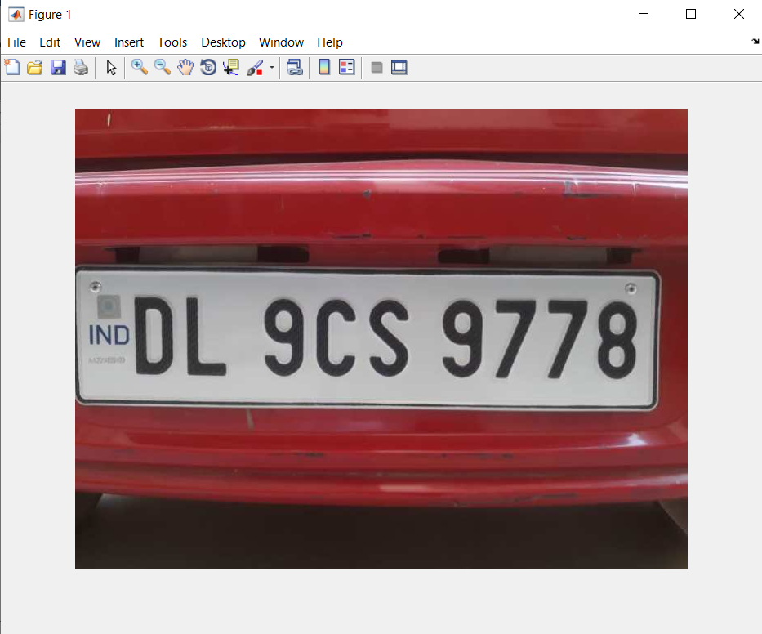
Original

Slide 12
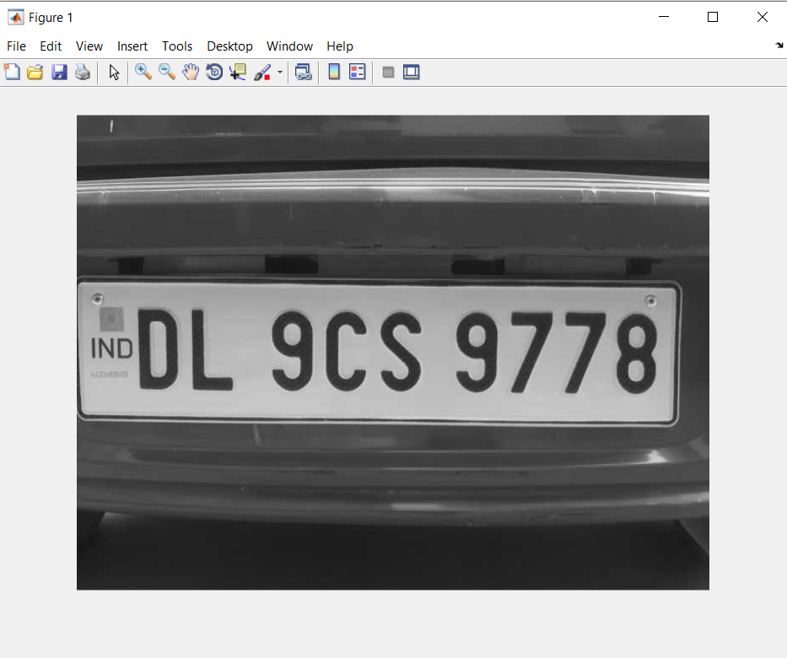
rgb2gray()

Slide 13
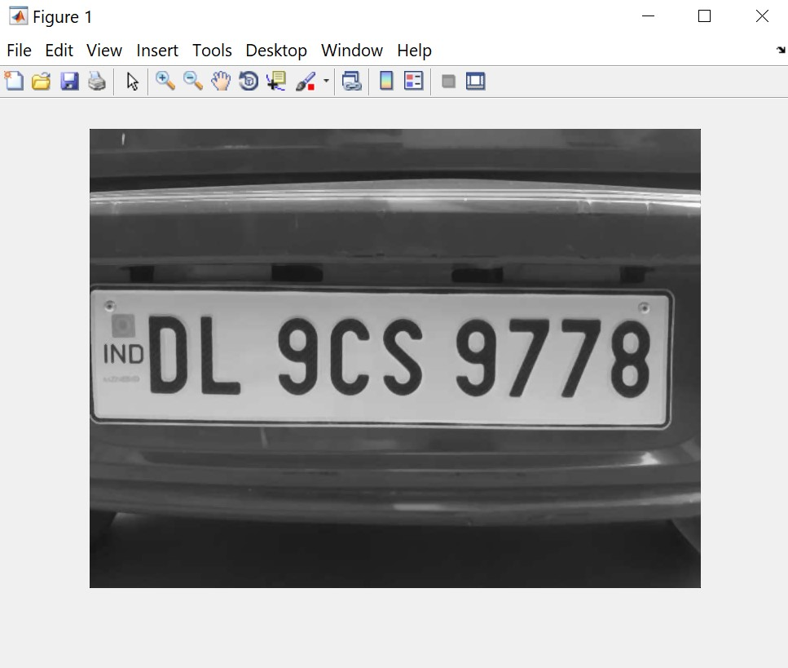
medfilt2()

Slide 14
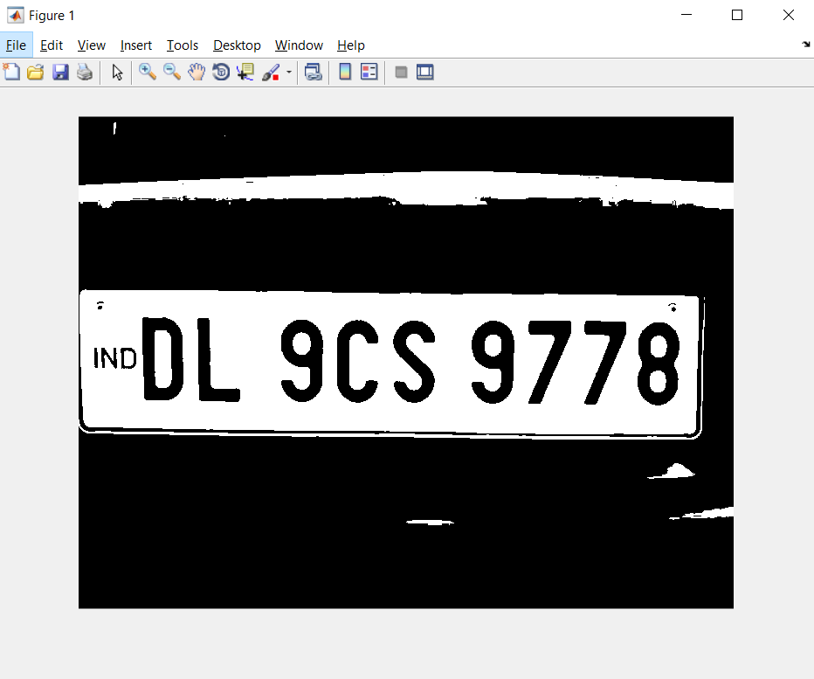
imbinarize()

Slide 15
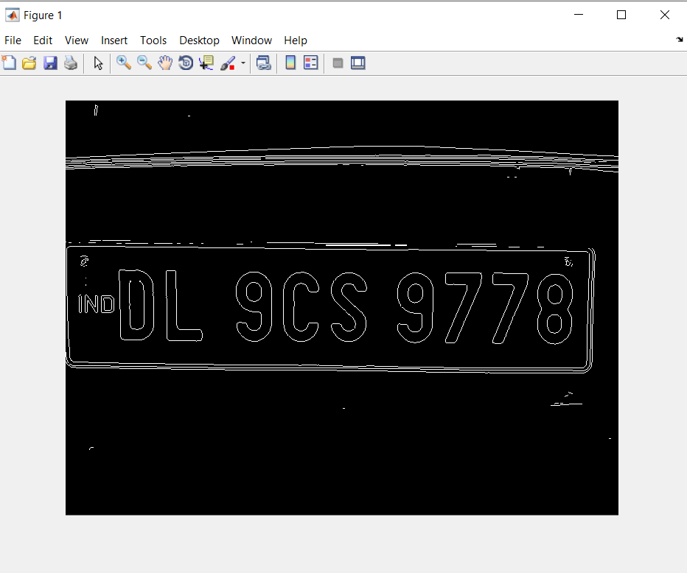
edge()

Slide 16
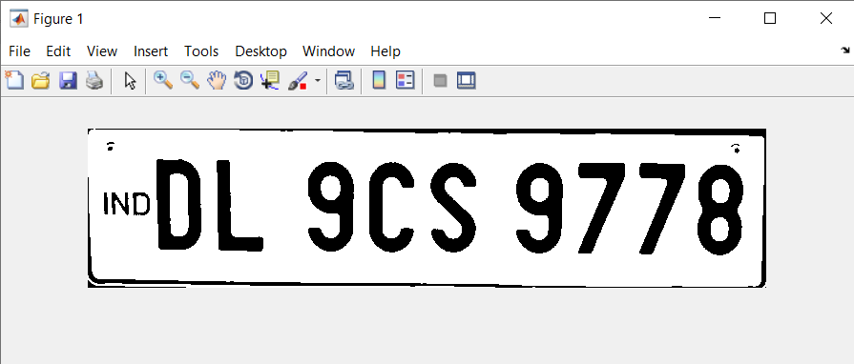
imcrop()

Slide 17
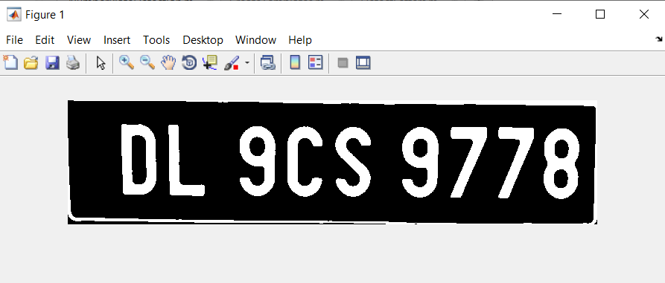
bwareaopen()

Slide 18
Identifying characters
Now the resulting image is divided into small bounding boxes which are stored in a matrix. This is done by measuring the properties of the image using regionprops() with the help of the arguement ‘BoundingBox’.
Now all the elements of the matrix are sent to DetectLetters() for identification and are appended one by one in the array plateNumber.
The final plate number is then stored in the variable plateNumber for future use.

Slide 19
Providing access to vehicles
Now the plateNumber is looked up in the already created database of registered vehicle numbers.
The registered numbers are stored in an excel file with the .xlsx extension which is accesed in MATLAB using the xlsread() function.
Now if the plateNumber is found in the database, acces is granted to the vehicle and the boom barrier is opened. Otherwise, access is denied and the boom barrier remains closed.

Slide 20
Automated boom barrier
The boom barrier is essentially an arm connected to an SG90 servo motor controlled by an arduino board.
This process is achieved by the writePosition() function which takes the angle of the servo motor as an argument.
The value of the angle varies between 0 and 1, i.e. 0 and 180 degrees.

Slide 21
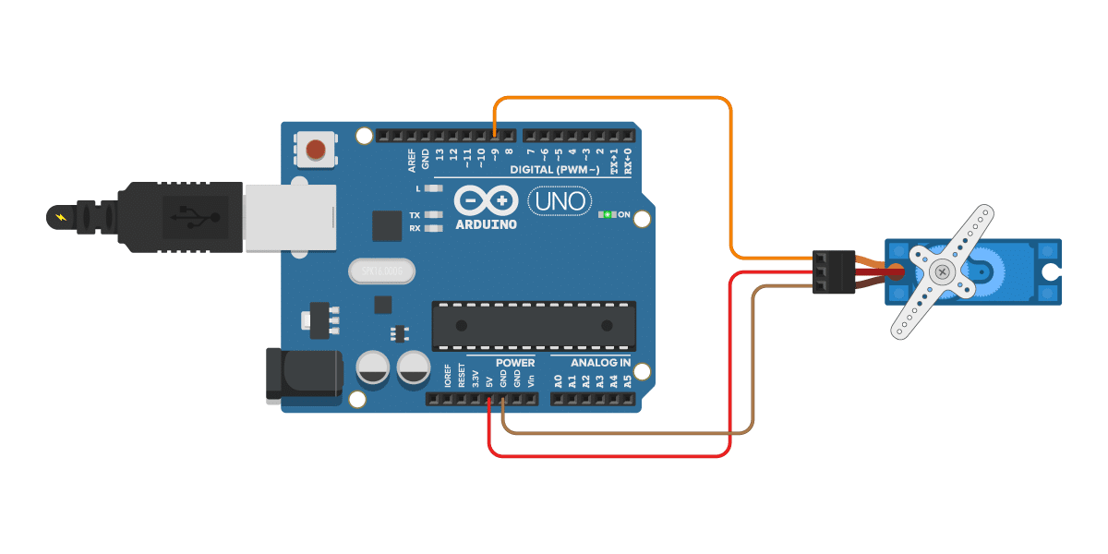
Circuit diagram for boom barrier

Slide 22
Database creation
All the detected plate numbers are then one by one appended in a matrix.
Also each time a vehicle passes, the date and time of arrival is stored in a variable using datetime(‘now’) function. This variable is apended in another matrix
Now both matrices are compiled together and saved in an excel sheet using the xlswrite(filname,matrixname,sheet,cell) function.

Slide 23
Working
The real time working of the model is shown in a
video on the next slide.

Slide 24


Slide 25
Scope of improvement
The project we made has an accuracy of around
92.22%. This project has a great scope of
improvement and these have been mentioned in the
following slides.

Slide 26
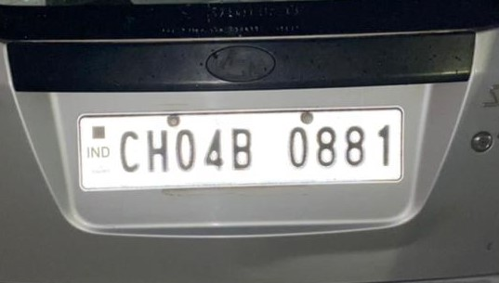
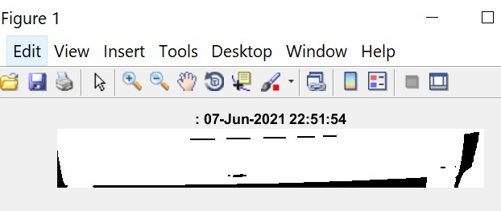
Scope of improvement
Tolerance to brightness

Slide 27
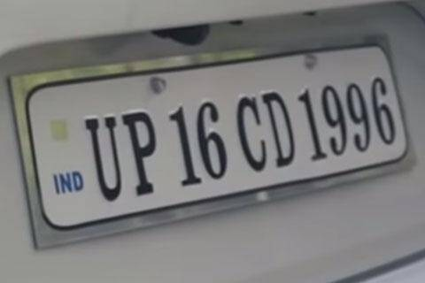
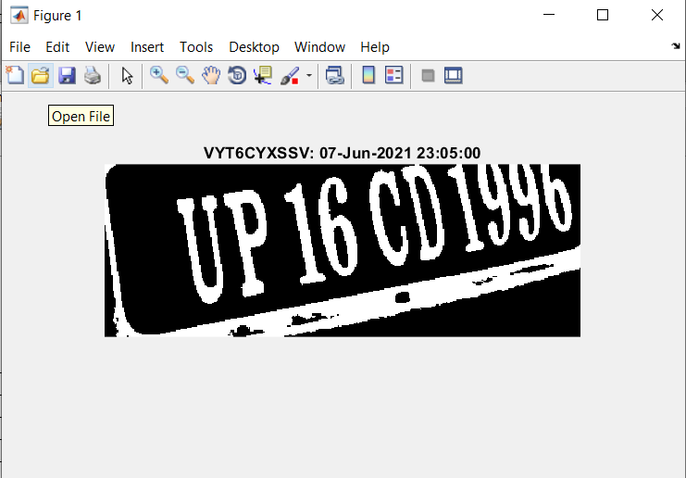
Scope of improvement
Inability to scan skewed images.

Slide 28

Scope of improvement
Low resolution and inconsistent font.

Slide 29
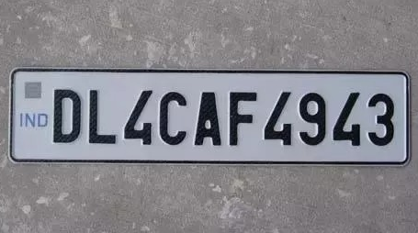
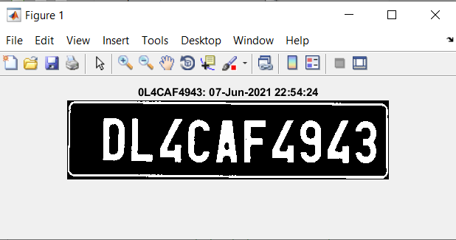
Scope of improvement
Similar Looking Characters:
Characters like ‘0’ and ‘D’, ‘A’ and ‘4’, etc, sometimes get interchanged in number plate. This happens due to the program characterizing ‘D’ as ‘0’ and ‘A’ as ‘4’, or vice versa.

Slide 30
Thank You

